Slide 1
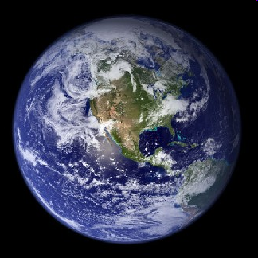
Global Climate Change
What is it?
Mark A. Cochrane
Professor
Geographic Information Science Center of Excellence (GIScCE)
South Dakota State University

Slide 2
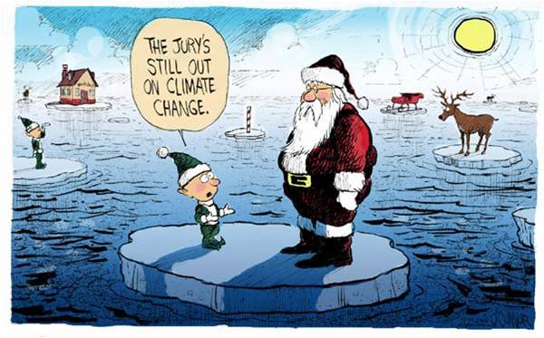
This is where we stand

Slide 3
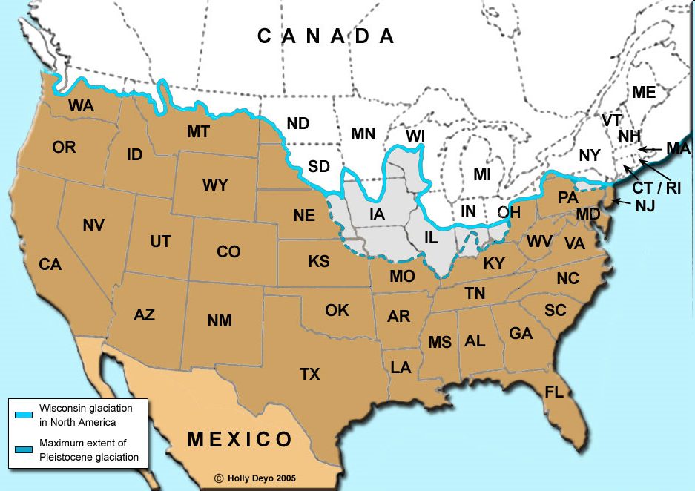
Climate changes
It always has and it always will
So why are we concerned now?
  1. We might not like the changes.
  2. We might be responsible.
The United States is expected to warm by 4-11°F by 2100 (USGCRP 2009).
  Is that a big deal?
  Depths of the Ice Ages
    9-11°F colder than today.

Slide 4
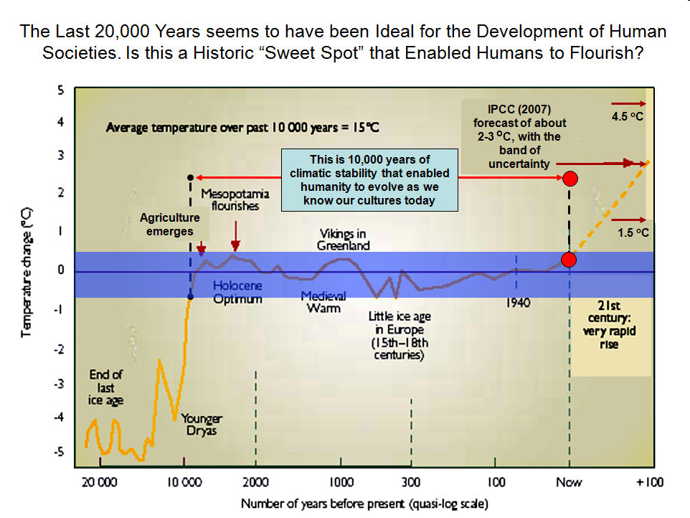
The agricultural cultures that we have created have benefitted from an unusually long period of climate stability
Notes:
http://climateprogress.org/2008/08/27/must-have-ppt-1-the-narrow-temperature-window-that-gave-us-modern-human-civilization/
One key explanatory background note if you use the slide: The IPCC forecast of a total of 2°C to 3°C is based on stabilizing atmospheric concentrations of CO2 around 550 ppm (a doubling from pre-industrial levels of 280), up from 385 today. The “band of uncertainty” involves the uncertainty about the climate sensitivity to a doubling of CO2 (absent the slow feedbacks). But as I have noted here before, the longer-term climate sensitivity to a doubling is probably much higher (see “Another “Must Read” from Hansen: ‘Long-term’ climate sensitivity of 6°C for doubled CO2“). In any case, we are headed to much more than 550 ppm this century. As the IPCC’s latest assessment makes clear, anything other than a sharp and rapid reversal in greenhouse gas emissions trends risks warming this century of 4°C or more (see “Is 450 ppm politically possible? Part 0: The alternative is humanity’s self-destruction“).

Slide 5
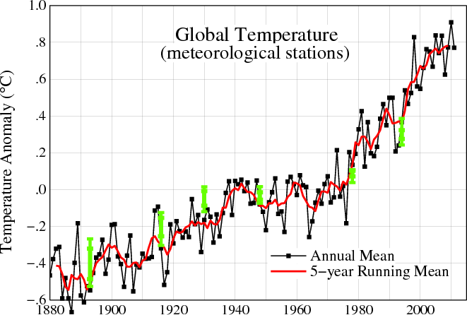
NASA Goddard Institute for Space Studies
Notes:
Except for a leveling off between the 1940s and 1970s, Earth's surface temperatures have increased since 1880. The last decade has brought the temperatures to the highest levels ever recorded. The graph shows global annual surface temperatures relative to 1951-1980 mean temperatures. As shown by the red line, long-term trends are more apparent when temperatures are averaged over a five year period. (Image credit: NASA/GISS)

Slide 6
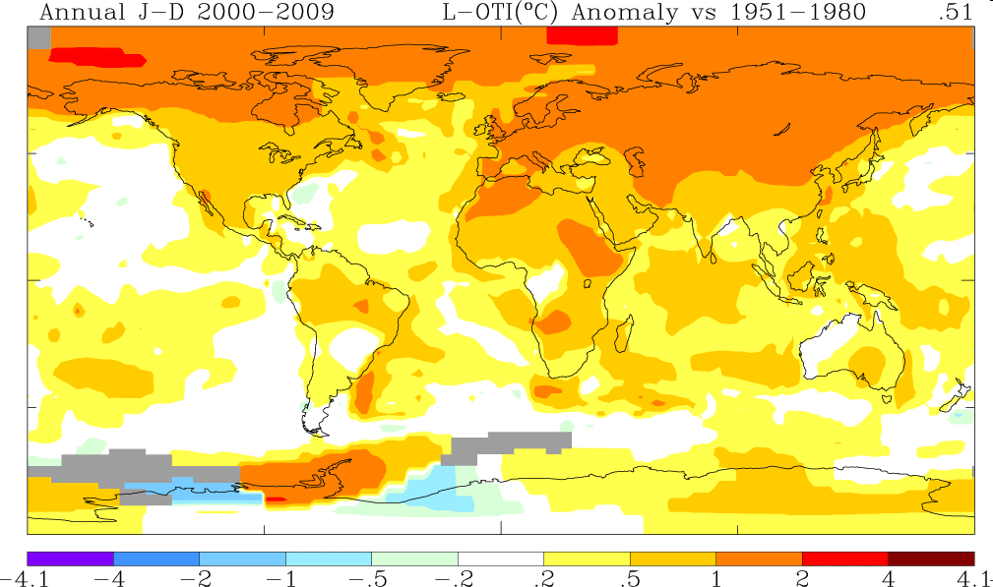
Warmest Decade on Record
(NASA Jan.21 2010)
Notes:
This map shows the 10-year average (2000-2009) temperature anomaly relative to the 1951-1980 mean. The largest temperature increases are in the Arctic and the Antarctic Peninsula. (Image credit: NASA/GISS)

Slide 7
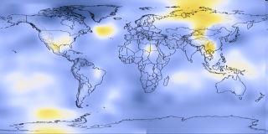
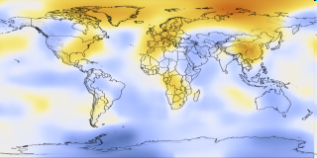
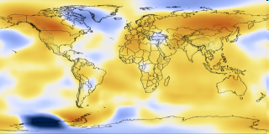
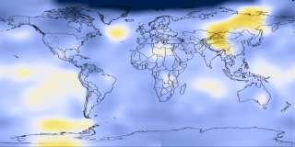
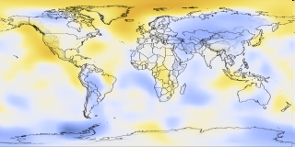
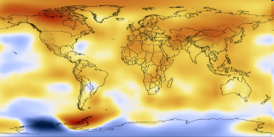
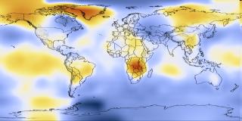
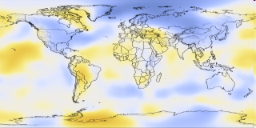
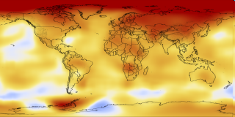
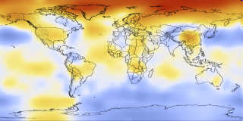
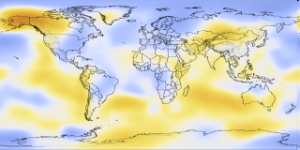

Five-Year Average Global Temperature Anomalies from 1909 to 2009
1905-1909
1915-1919
1925-1929
1935-1939
1945-1949
1955-1959
1965-1969
1975-1979
1985-1989
1995-1999
2005-2009

Slide 8
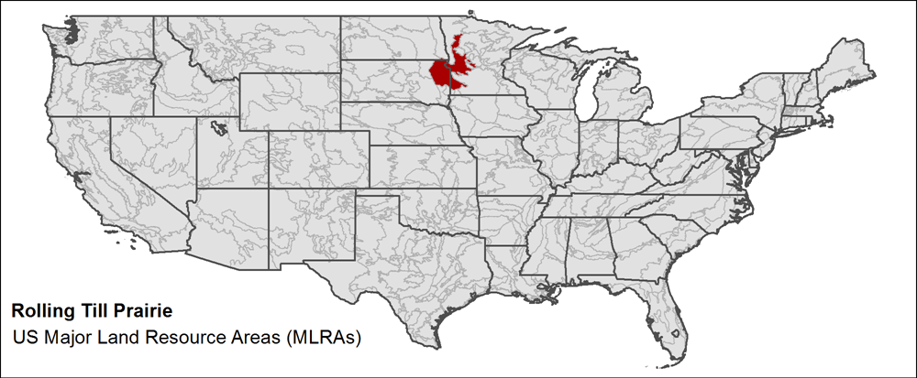
What about Brookings?

Slide 9
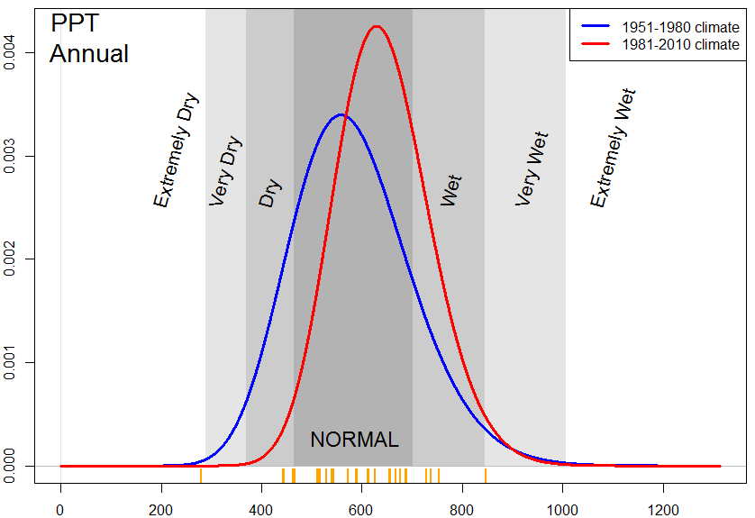

Slide 10
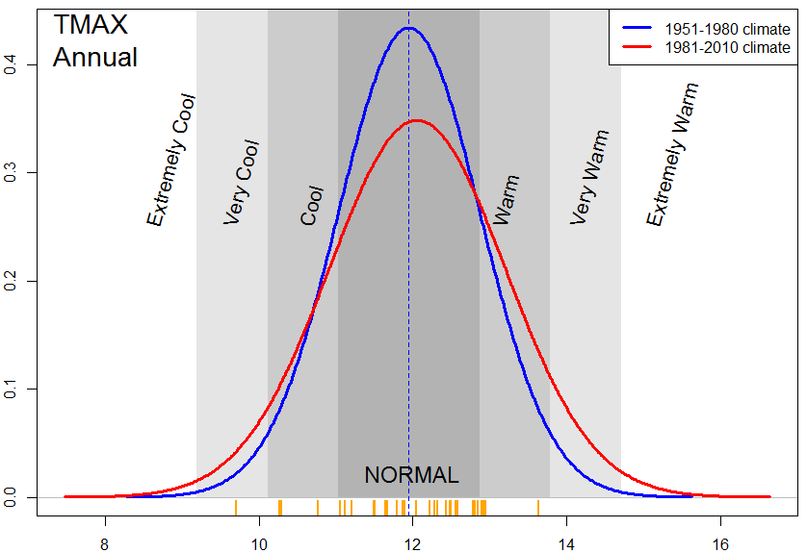

Slide 11
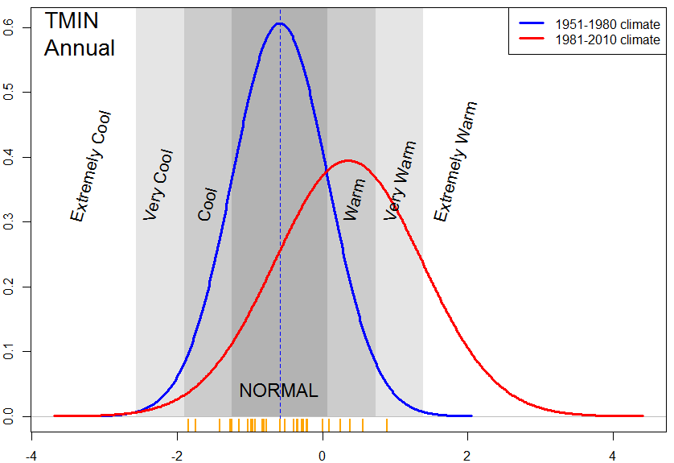

Slide 12
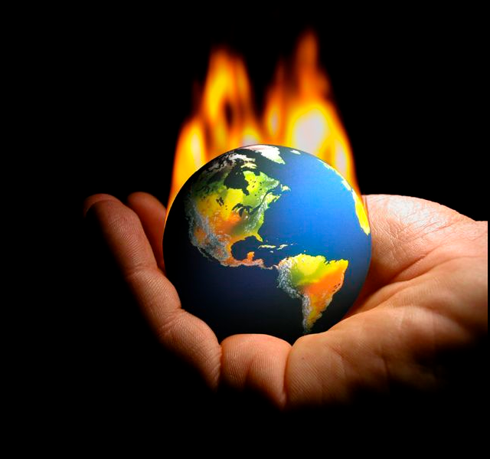
How can the Earth be heated?
At its simplest ‘global warming’ boils down to three possibilities.
The globe will warm if:
  The Sun gets brighter
  The Earth gets darker
  The Earth cannot radiate heat fast enough to balance the incoming solar energy

Slide 13
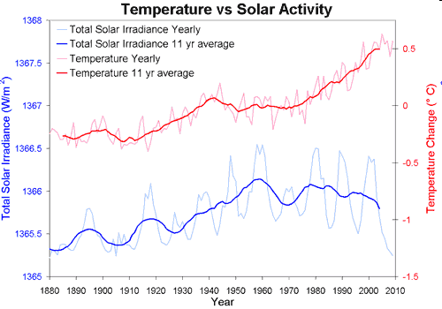
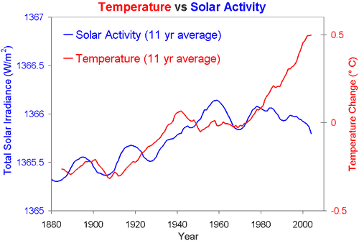
Has the Sun been getting brighter?
In short,
  No.
During the last 35 years the solar ‘constant’ has actually decreased.
Solar cycle 24 is now occurring so we should experience roughly 0.24 W/m² heating by 2013
Disconnect?
Notes:
Krivova et al. 2007 – TSI data
PMOD – TSI 1978-2009
NASA GISS Temp
Figure from http://www.skepticalscience.com/2009-2nd-hottest-year-on-record-sun-coolest-in-a-century.html

Slide 14
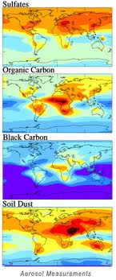
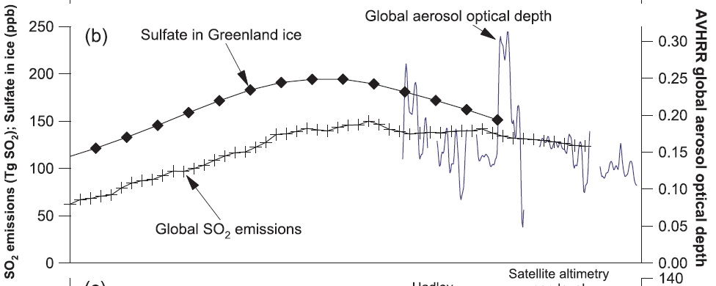
Has the Earth been getting darker?
In short,
  No, if anything it has been brighter.

Slide 15
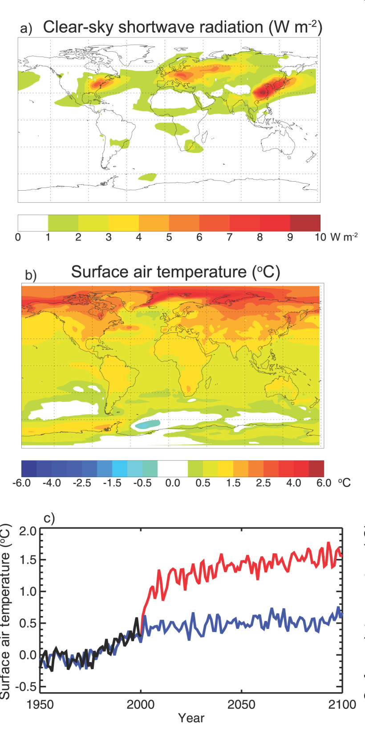
The Upside of Pollution?
Aerosols have shielded the planet from even greater warming.
If we were to suddenly stop emitting pollutants to the atmosphere the planet would warm by an additional 0.8°C within a few years.
IPCC 2007

Slide 16
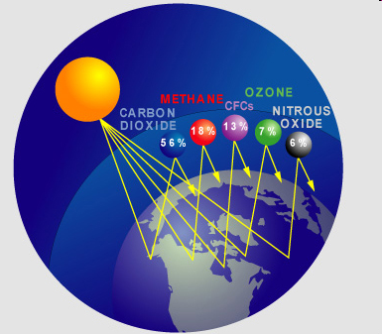
Process of elimination means…
Something must be keeping energy (heat) from escaping like it previously did.
That ‘something’ is the infamous set of anthropogenic greenhouse gases, which include:
  Carbon dioxide
  Methane
  Halocarbons
  Ozone
  Nitrous oxide

Slide 17
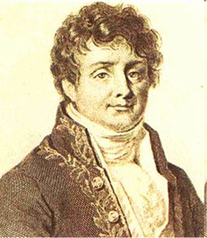
The ‘Greenhouse’ Effect
Certain gases are transparent to visible light but absorb infrared radiation (heat)
Note, there is no controversy about the existence of the greenhouse effect!
In 1824, Joseph Fourier published the first scientific paper describing how an atmosphere serves to warm a planet.
Earth’s greenhouse gases warm the planet by approximately 33°C (59°F).
  If it wasn’t for the atmosphere the Earth would have an average temperature of -18°C (0°F).
Notes:
Derived from Wikipedia

Slide 18
How does it work?
It’s actually a lot like how you manage your own body temperature at night…..
Murphy et al. 2009

Slide 19
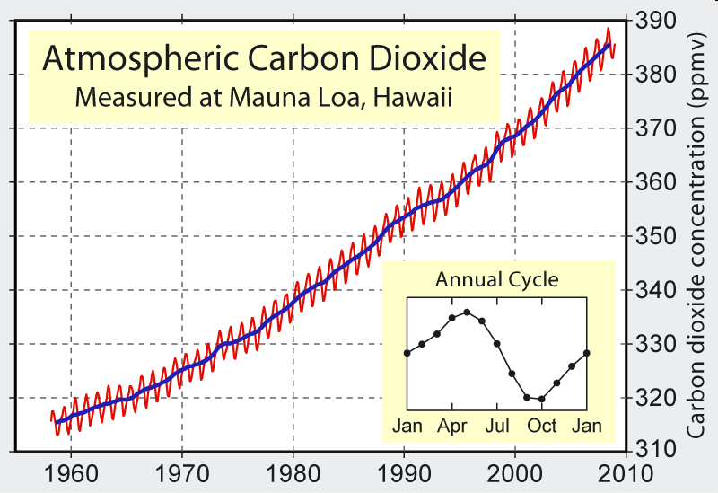
What is the controversy?
Are we increasing the greenhouse effect?
Atmospheric carbon dioxide has grown from 315 parts per million (ppm) in 1958 to 392 (ppm) in 2011.

Slide 20
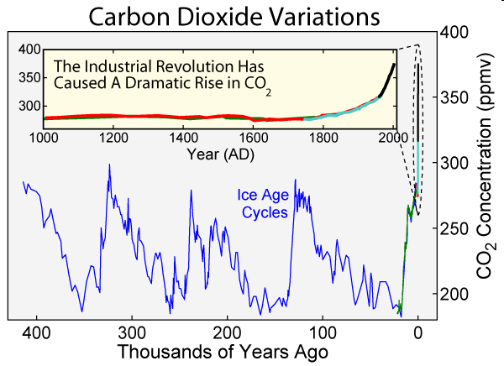
But is it us?
392 ppm in 2011
650,000 years below 300ppm

Slide 21
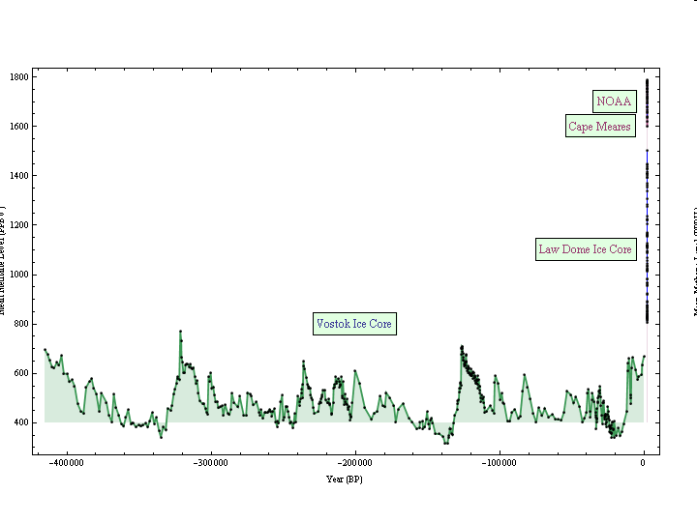
Yes, it is us
Methane
As of 2012, we are above 1800ppb
For 650,000 years, below 800ppb ……

Slide 22
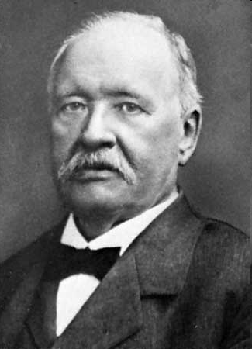
The idea of Anthropogenic Greenhouse Warming (AGW) is not new!
In 1896, Svante Arrhenius estimated that doubling CO₂ levels would cause global temperatures to rise by 9-11 °F (5 - 6 °C).
  Recent IPCC estimates of temperature increases for CO₂ doubling are between 2 and 4.5 °C (IPCC 2007).
  These estimates continue to rise as our understanding grows.
Arrhenius expected it to take us 3,000 years to double CO₂ levels.
  Most scenarios currently estimate doubling to take about 100 years.

Slide 23
Global Climate Models (GCMs) are controversial though….
So let’s stick to existing observations
Accumulated energy
Where did it go?
Murphy et al. 2009

Slide 24
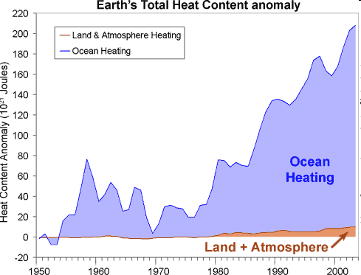
Where is the heat going?
70% of the Earth’s surface is actually ocean
Most of the heat is accumulating in the water

Slide 25
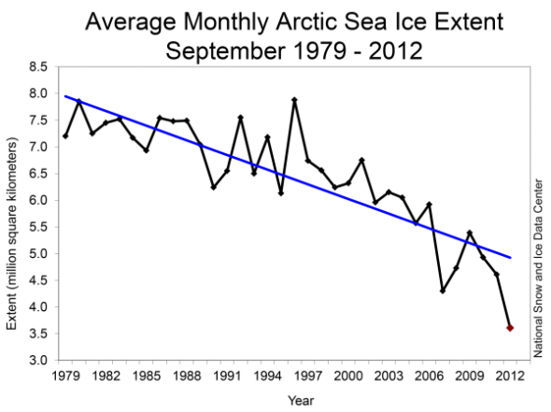
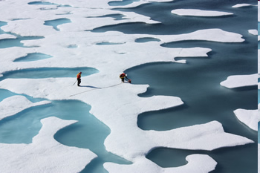
So what if the water warms a little?
It takes 80 times as much energy to melt ice as it does to heat water by 1°C.
September ice extent from 1979 to 2012 has declined by 13.0 percent per decade. This year is 4 million km2 lower than 1979 (20 South Dakota’s)
Why should we care?
Ice reflects 80% of solar energy, water absorbs 80%

Slide 26
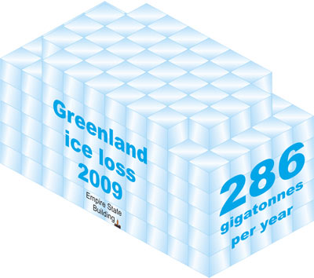
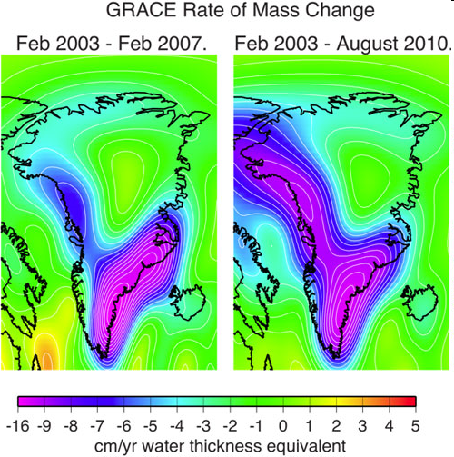
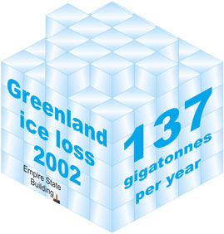

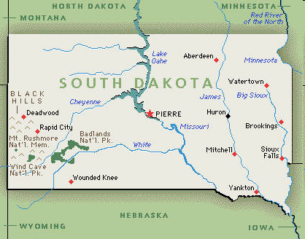
Ice on Land is Melting Too
A cubic kilometer of ice (actually 1055 m³) = 1 gigatonne
In 2002, Greenland was losing ice at a rate of 137 gigatonnes per year.
By 2009, Greenland’s rate of loss had increased to 286 gigatonnes per year.
That rate is increasing by 30 Gt/yr
In 2009, Antarctica’s rate of loss was an additional 246 Gt/yr
That rate is increasing by 26 Gt/yr
Therefore, this year (2012), roughly 700 gigatonnes of ice is being melted.
That’s enough to cover every square inch of South Dakota with 11.5 ft of ice!
Notes:
Ice images from Cook 2010 (Skeptical Science website)
Data from Velicogna 2009 (GRL)

Slide 27
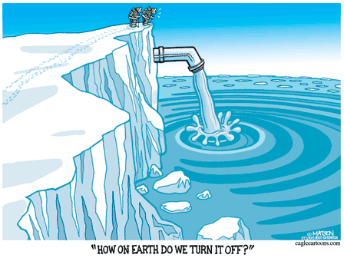
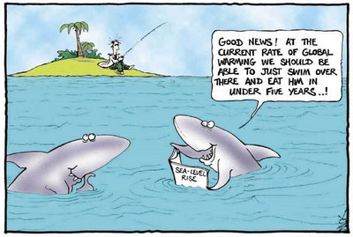
Rates of Change in Global Temperature and Sea Level Rise
We should be more concerned about the rising water than the fluctuating temperature
Murphy et al. 2009

Slide 28
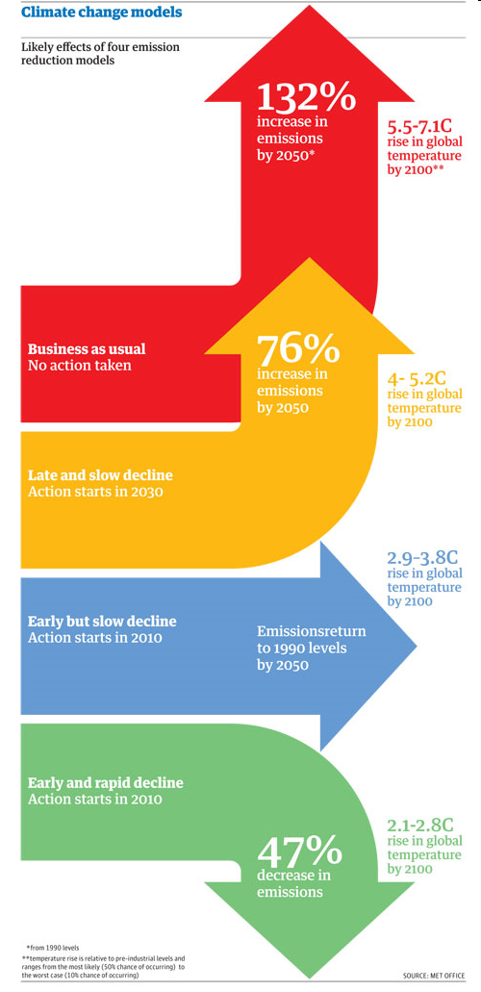
What have we learned in recent years?
Melting of glaciers, sea ice and ice sheets have all exceeded predictions
Greenhouse gas emissions have met or exceeded worst-case scenarios
Sea level rise predictions have more than doubled
The ability of the sea and land to take up excess carbon has been decreasing
The feedbacks releasing carbon from the land have been increasing
In short, climate changes have continually outpaced predictions
What does the future hold?

Slide 29
The agricultural cultures that we have created have benefitted from an unusually long period of relative climate stability
Business as usual
Delayed Action
Slow Action
Urgent Action
Notes:
http://climateprogress.org/2008/08/27/must-have-ppt-1-the-narrow-temperature-window-that-gave-us-modern-human-civilization/
One key explanatory background note if you use the slide: The IPCC forecast of a total of 2°C to 3°C is based on stabilizing atmospheric concentrations of CO2 around 550 ppm (a doubling from pre-industrial levels of 280), up from 385 today. The “band of uncertainty” involves the uncertainty about the climate sensitivity to a doubling of CO2 (absent the slow feedbacks). But as I have noted here before, the longer-term climate sensitivity to a doubling is probably much higher (see “Another “Must Read” from Hansen: ‘Long-term’ climate sensitivity of 6°C for doubled CO2“). In any case, we are headed to much more than 550 ppm this century. As the IPCC’s latest assessment makes clear, anything other than a sharp and rapid reversal in greenhouse gas emissions trends risks warming this century of 4°C or more (see “Is 450 ppm politically possible? Part 0: The alternative is humanity’s self-destruction“).

Slide 30
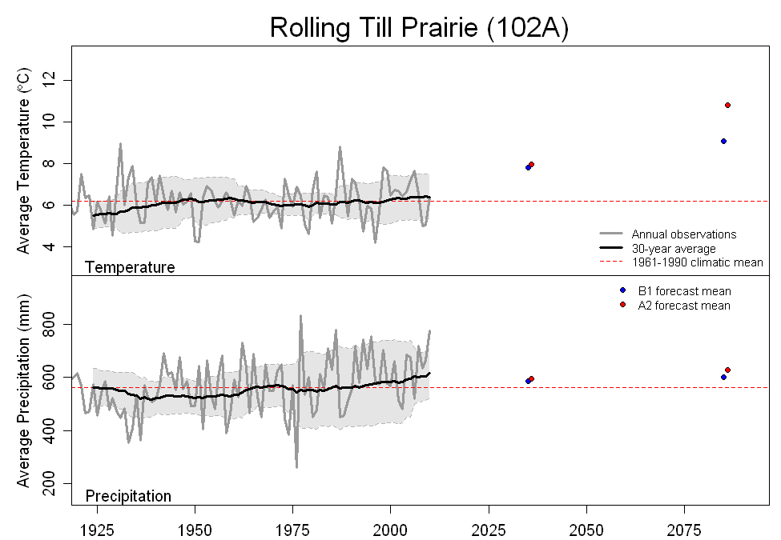
What does the future hold for Brookings?

Slide 31
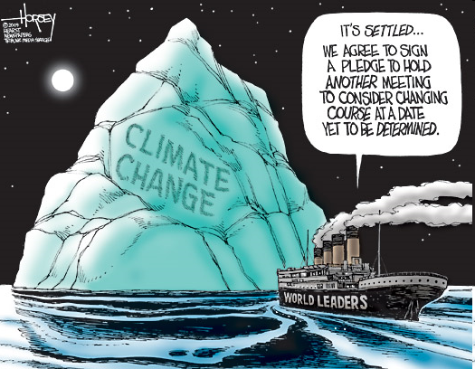
What is the world doing about this?
Not too much beyond having meetings
The next United Nations Climate Change Conference (COP) will be held from 26 November – 7 December, 2012 in Doha, Qatar.
There are no expectations of significant agreements

Slide 32
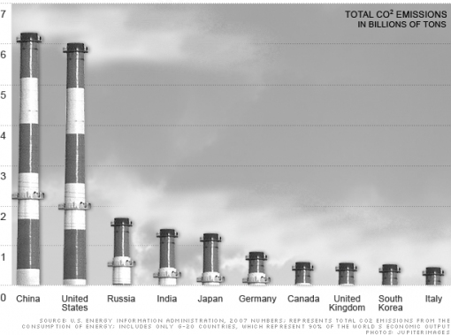
Where do we fit in?
No matter how you sugarcoat it, we are a big part of the problem and need to be part of any attempted solution

Slide 33
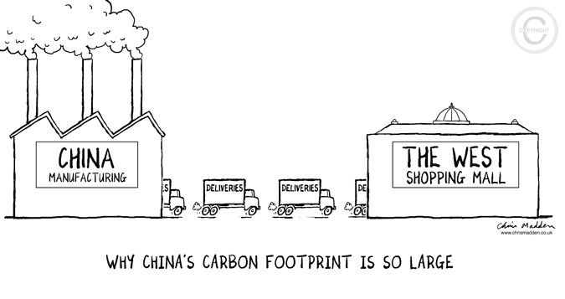
Where do you fit in?
Start reducing your ecological/carbon footprint
Conserve resources and energy!
Walk/bike to school
Plant a garden
Buy locally grown food
Use less stuff….
Learn, learn, learn (this is serious)
Teach your friends, family and others

Slide 34
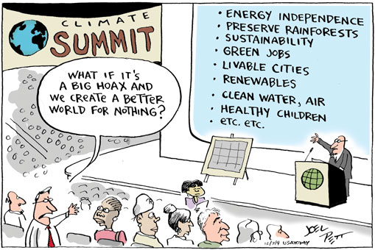
But what if thousands of scientists got it wrong….?

Slide 35
Questions?

